Slide 1
Introduction

Slide 2
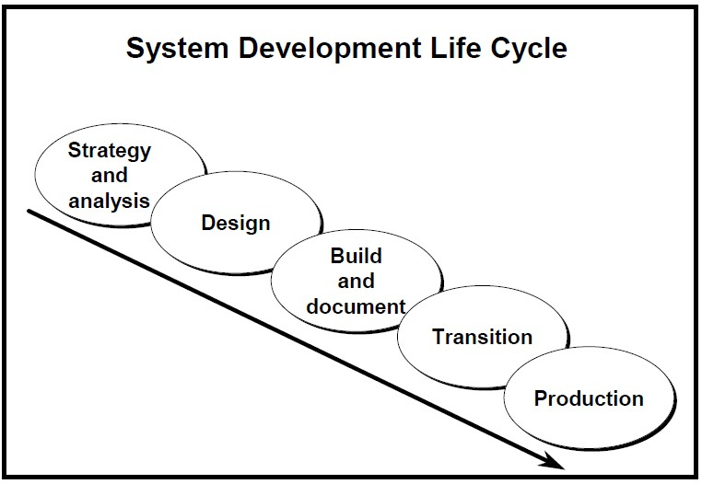
Strategy and analysis: study and analyze the business requirements.
Design : design the database based on point 1
Build and document: build the prototype system, write and execute commands to create the tables and objects, build user documentation.
Transition: move the application to production, take acceptance form users and make modification if required.
Production: roll out the system to users.

Slide 3
What is Data?
Pieces of information.
What is database?
It is organized collection of information.
What is DBMS?
Database management system to store and retrieve and modify data in the database.
And because Oracle is relational database, then we have RDBMS Relational database management system.
and also in oracle we have
ORDBMS ("Object-Relational Database Management System")

Slide 4
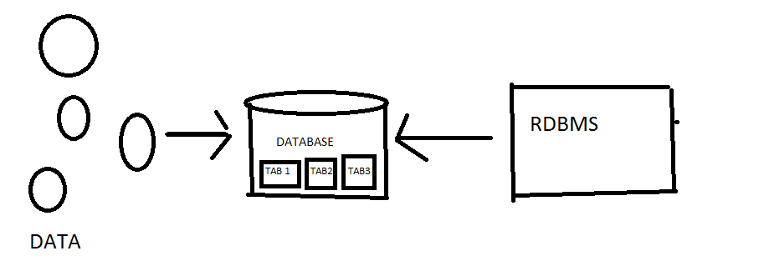
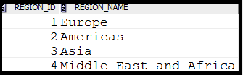
What is the table?
It is the basic storage of an RDBMS

Slide 5
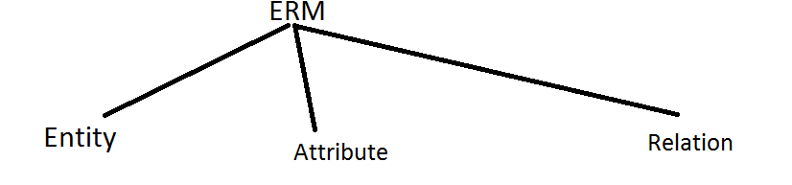
What is Data models?
Conceptual tools to describe data.
ERM (entity relation model)
Entity
An entity can be a real-world object, that can be easily identifiable. For example, in a school database:
students, teachers, and courses offered can be considered as entities.
Attributes
Things that describe the Entity. ( student name, age, birthday …)
Relationship
The association among entities is called a relationship. For example, an employee works_at a department,
a student enrolls in a course.

Slide 6
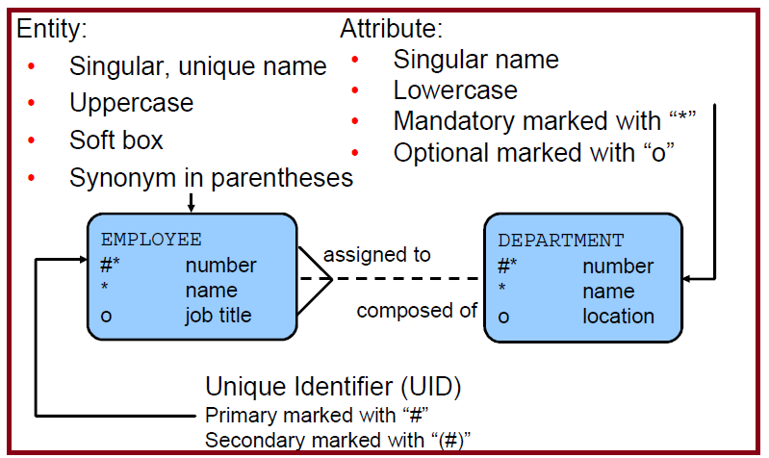

Slide 7
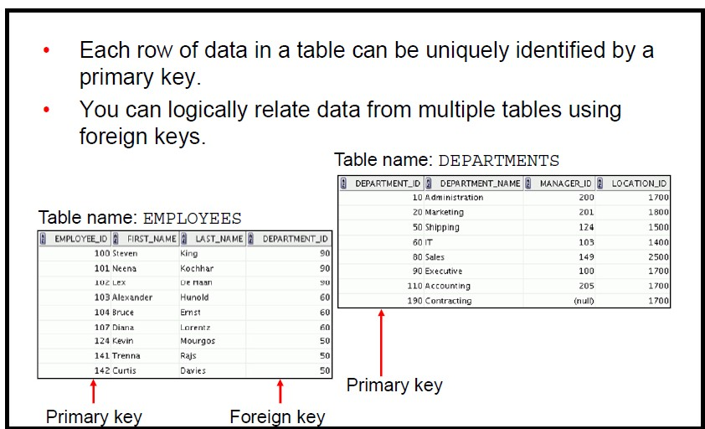

Slide 8
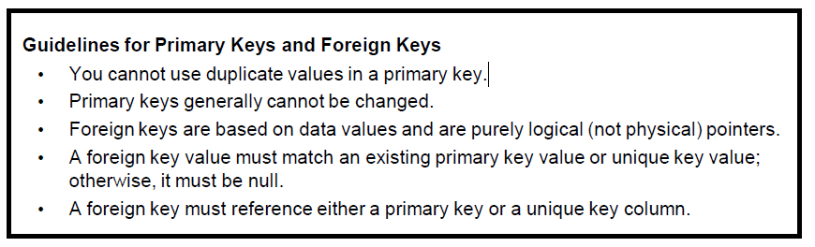

Slide 9
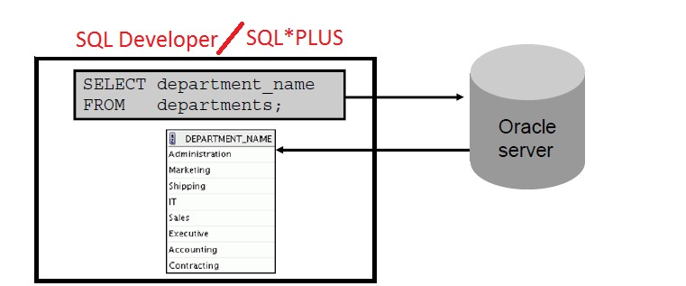

To access Oracle database you need SQL
SQL is structure query language to access database
To write SQL statements you need development environments SQL*PLUS or Oracle SQL developer ( the primary tool )
Username password

Slide 10
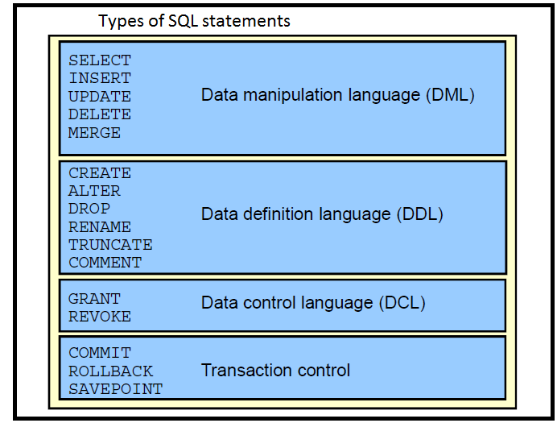

Slide 11
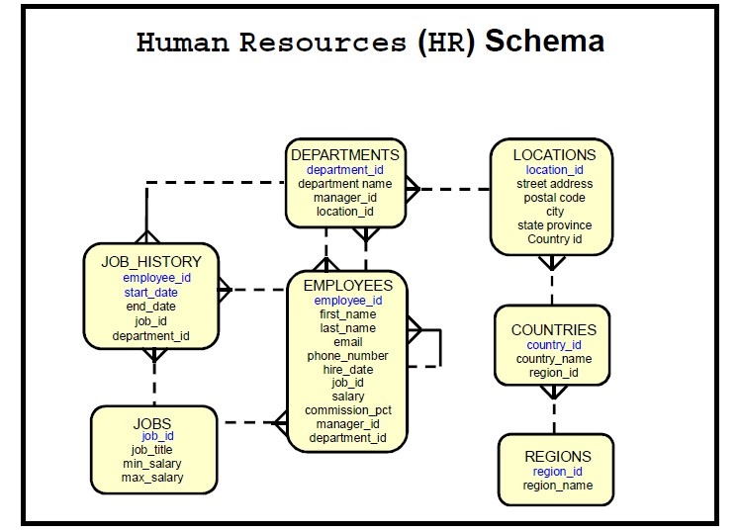

Slide 12
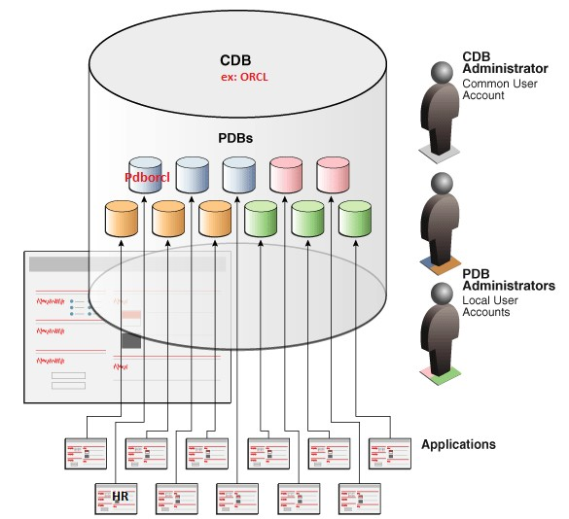
Architecture for Database 12c

Slide 13
Thank You
Prepared By :Khaled AlKhudari
16

